Slide 1
Interswitch Data Science Assessment
ADEOLUWA ADEGBOYE

Slide 2
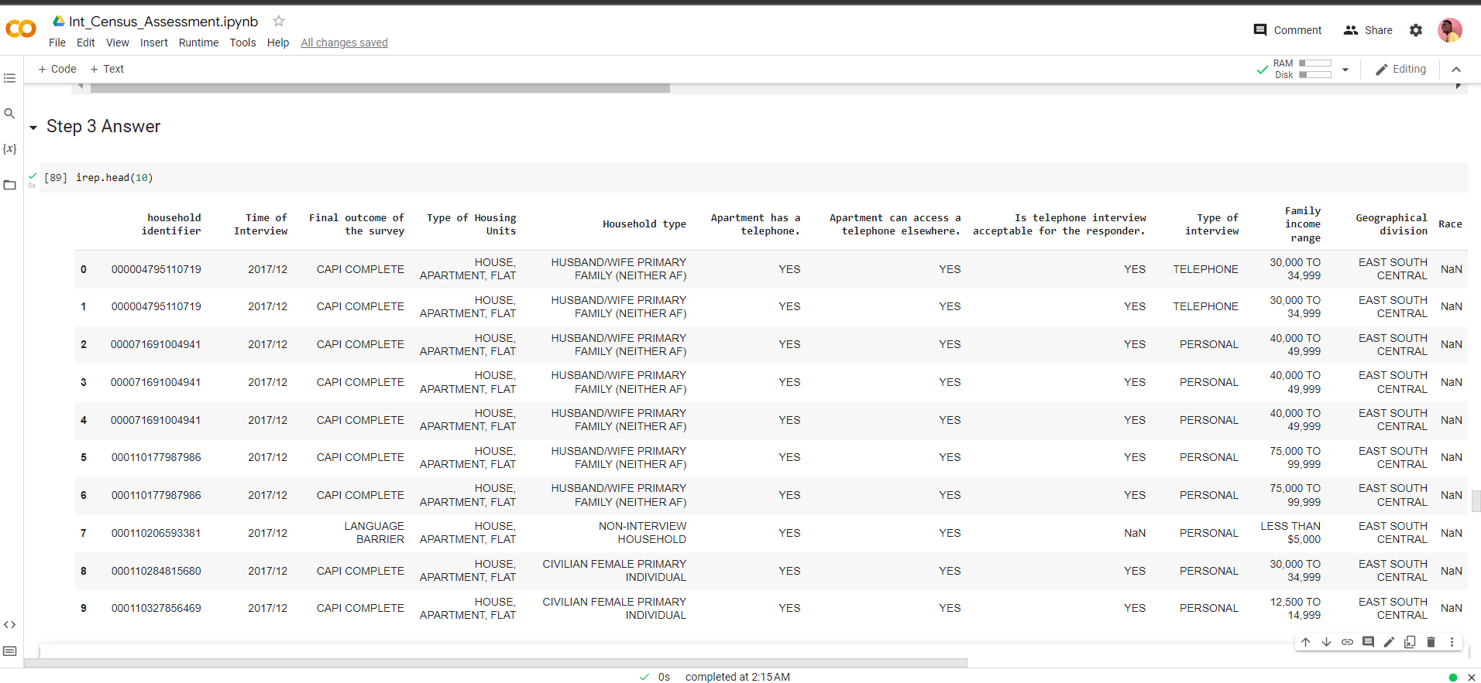
A Sample of 10 records for the 12 features outlined in the Assessment Question

Slide 3
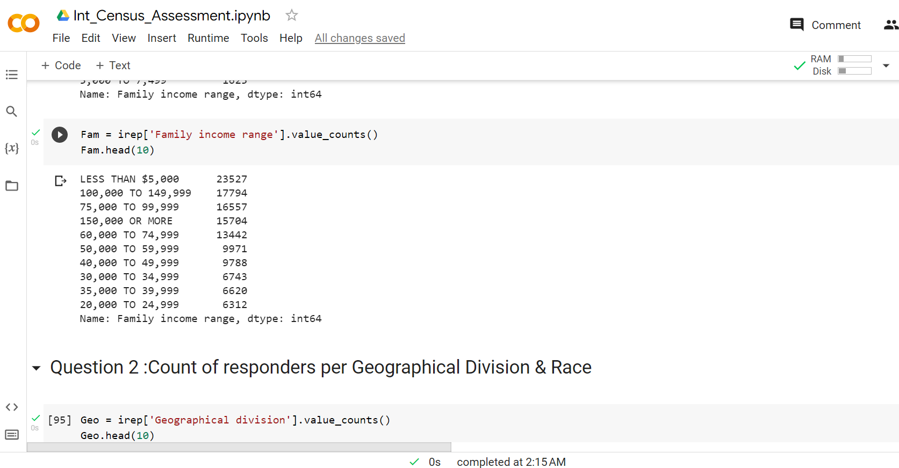
Q1: What is the count of responders per family income range (top 10)

Slide 4
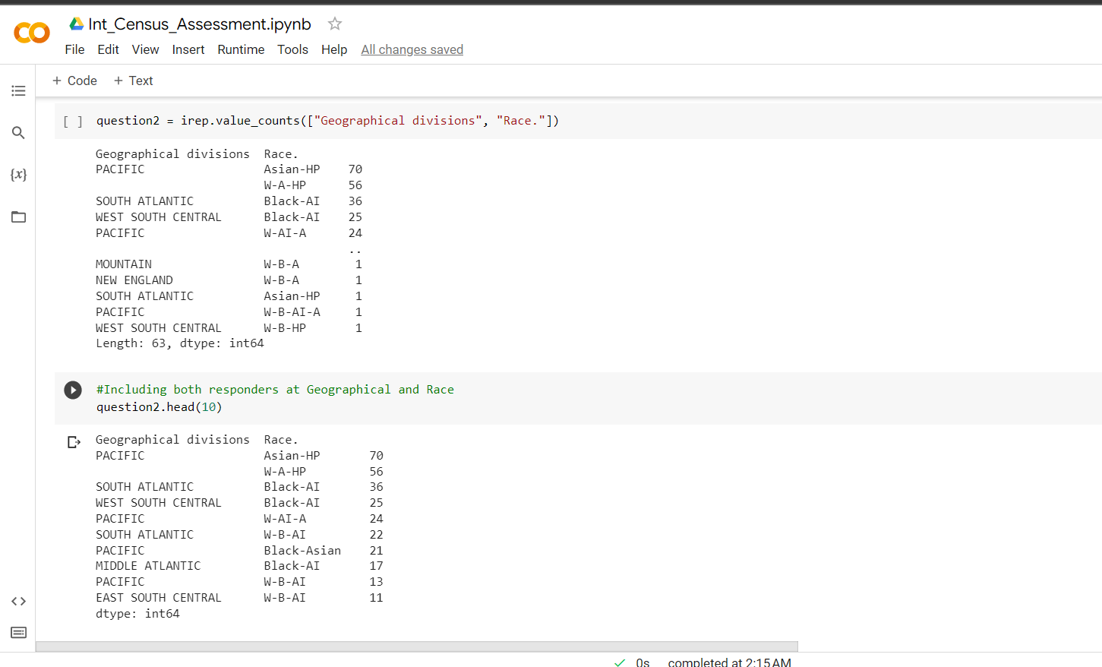
Q2: What is the count of responders per geographical division/location & race? (Top 10)

Slide 5
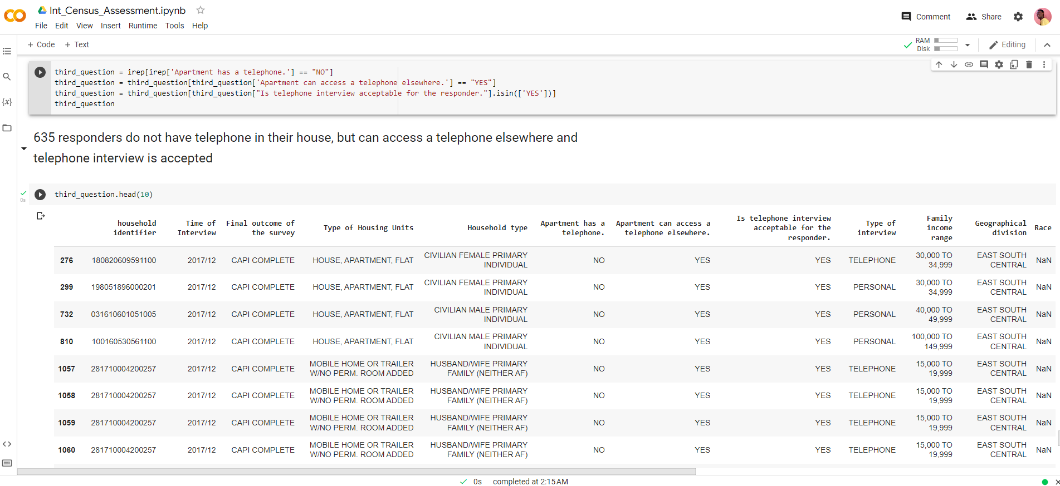
Q3: How many responders do not have telephone in their house, but can access a telephone elsewhere and telephone interview is accepted?

Slide 6
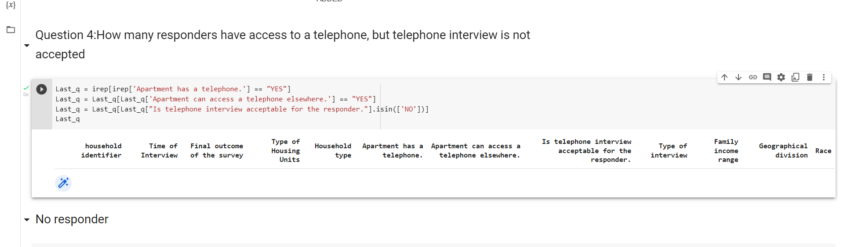
Q4: How many responders do not have telephone in their house, but can access a telephone elsewhere and telephone interview is accepted (show top 10)?

Slide 7
Thank you for your consideration

